Slide 1
Unit 201: Health and safety in building services engineering
Manual handling

Slide 2
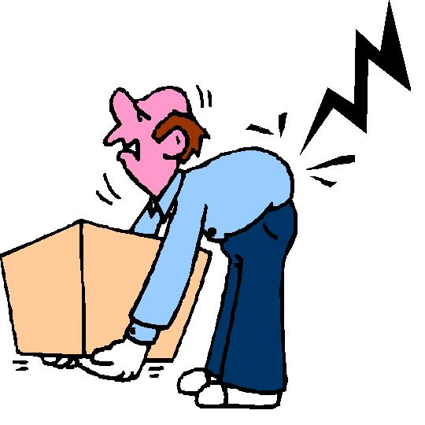
Manual handling
Often manual handling and lifting can cause immediate pain and injury; this type of injury is called acute injury.
Sometimes the result of an injury can take weeks or months – or even years – to develop. These types of injuries are called chronic injuries.

Slide 3
Manual handling
The most common injuries are:
torn ligaments and tendons
hernias
slipped discs
sprains to muscles and joints.

Slide 4
Manual Handling Operations Regulations 1992
These regulations require employers to reduce the risks from manual handling:
by avoiding manual handling if possible
where manual handling cannot be avoided, automating or mechanising the lifting process as much as possible to reduce risk of injury.

Slide 5
Manual Handling Operations Regulations 1992
Here are some points for you to consider before attempting any lifting or handling operation:
be aware of your own strength and limitations
decide if it is a one-man operation or whether you require help
always use mechanical equipment or aids if available
be sure of the weight of the item before lifting
wear gloves to protect your hands
wear safety boots to protect your feet
check that the area is clear and safe to carry out lifting.

Slide 6
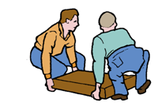
Handling techniques
In order to avoid injury, the following principles should be followed.
Plan the lift
Know where the load is going to be placed.
Plan the route – remove any obstacles and discard any wrapping materials.
Place the feet correctly: feet apart, giving a balanced and stable base for lifting, with leading leg as far forward as is comfortable.

Slide 7
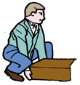
Handling techniques
In order to avoid injury, the following principles should be followed.
Lifting
Crouch down in front of the object with feet apart and one foot alongside the object (ahead of the other foot).
Hold the load as close to your body as possible.
Keep the back straight at all times – let the leg muscles do the work.
Push off with rear foot and move off in one smooth movement.

Slide 8

Handling techniques
In order to avoid injury, the following principles should be followed.
Carrying
Keep your arms close to the body.
Take a good hold of the object: grip with the palms and the roots of the fingers.
Avoid twisting or leaning, as this will strain your back. Turn by moving your feet, not your body.
Avoid pinching fingers when releasing the object.
Hold the load so that a clear view ahead is possible.
Put the load down carefully. If necessary, adjust the position after the load has been put down.

Slide 9
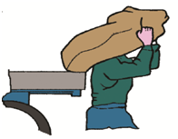
Handling techniques
In order to avoid injury, the following principles should be followed.
Carrying loads on the back
Keep your back straight by raising the top of the head slightly and by tucking in the chin.

Slide 10
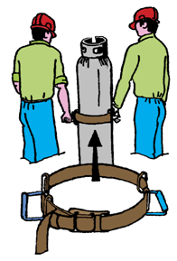
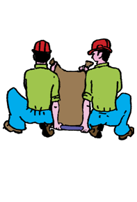
Handling techniques
In order to avoid injury, the following principles should be followed.
Two-person lift

Slide 11
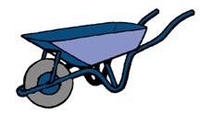
Lifting gear
Wheelbarrow

Slide 12
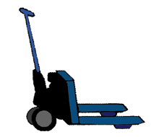
Lifting gear
A pallet truck can be used on hard areas for moving heavy loads.

Slide 13
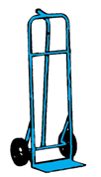
Lifting gear
A sack truck can be used for moving bagged materials and paving slabs.

Slide 14
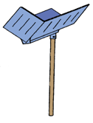
Lifting gear
A hod can be used for moving bricks on to higher levels such as scaffolds.

Slide 15
Unit 201: Health and safety in building services engineering
The End

